Slide 1
Sanbai
Apparel

Slide 2
Men's Baseball Jackets
CONTENTS
01
04
Men's casual jackets
Men's windbreakers
02
05
Men's softshell jackets
Men's baseball jackets
03
06
05
Men's faux leather jackets
Men's demin jackets
01

Slide 3
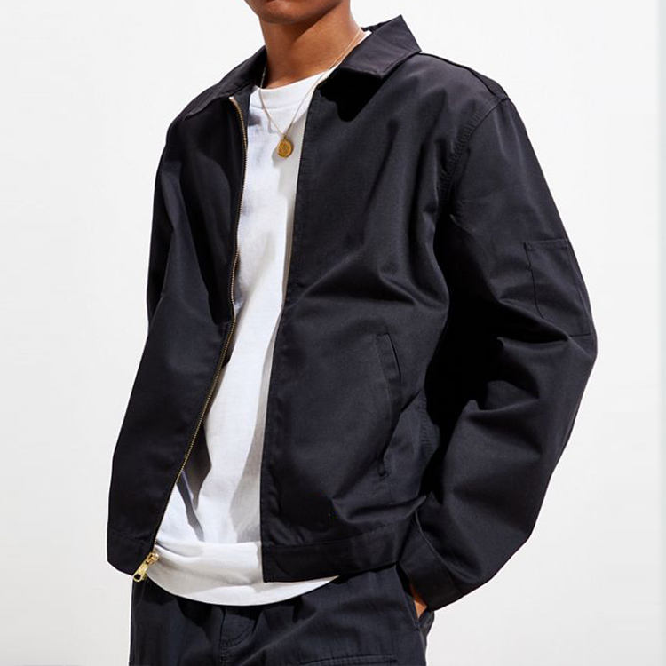
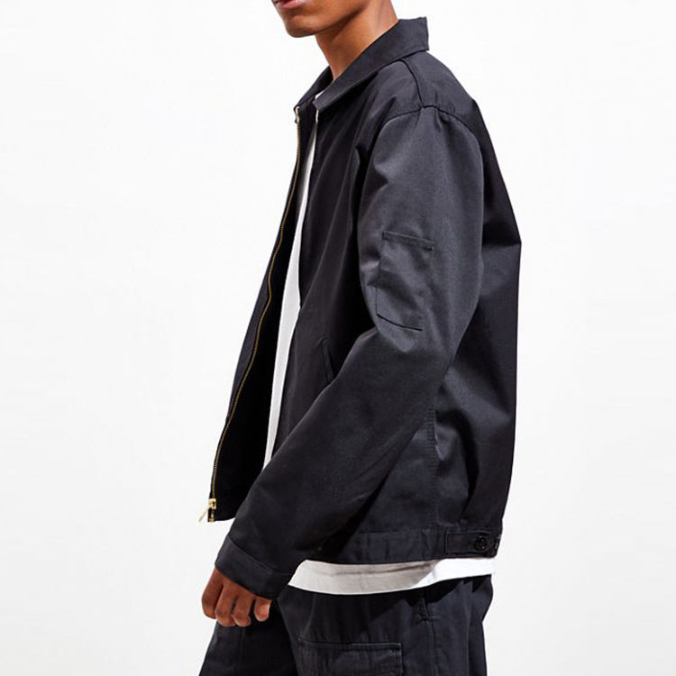
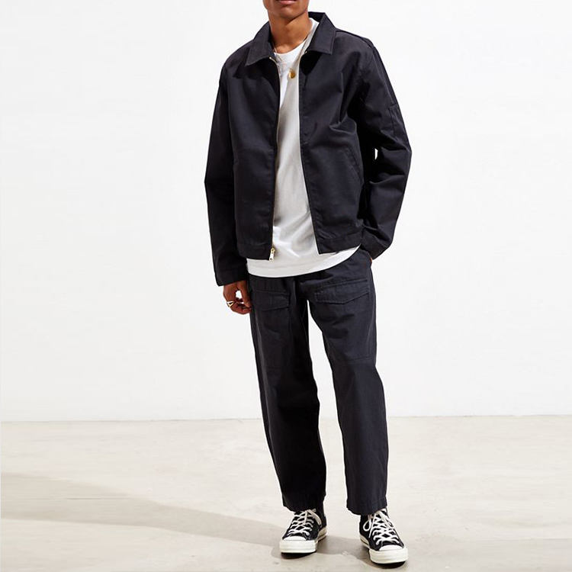
01
Men’Causal Jackets
Model Number:
BYM-6591
MOQ:
300 pcs/design/color
100% cotton mens fashion work jackets with sleeve pocket

Slide 4
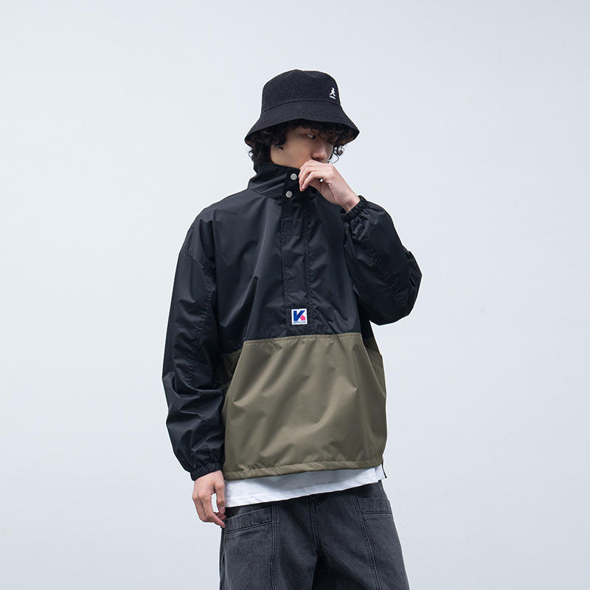
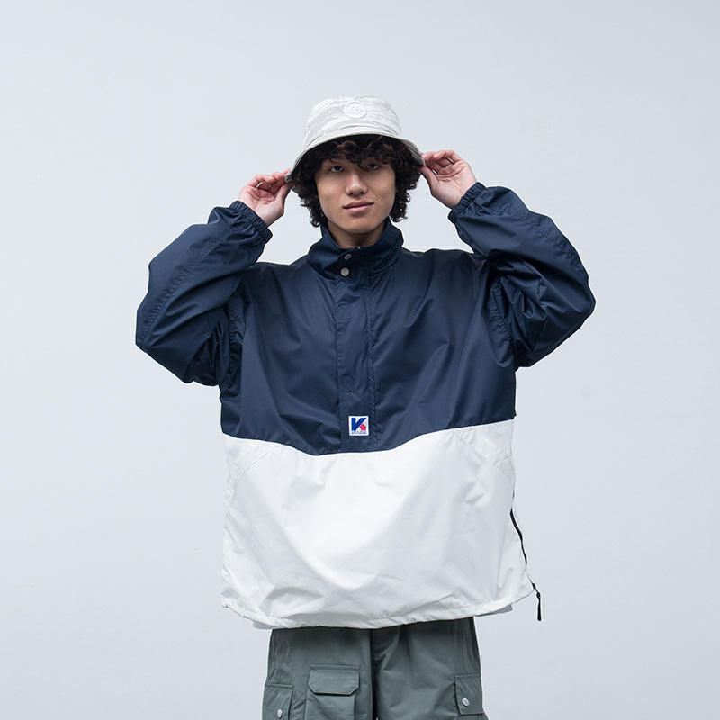
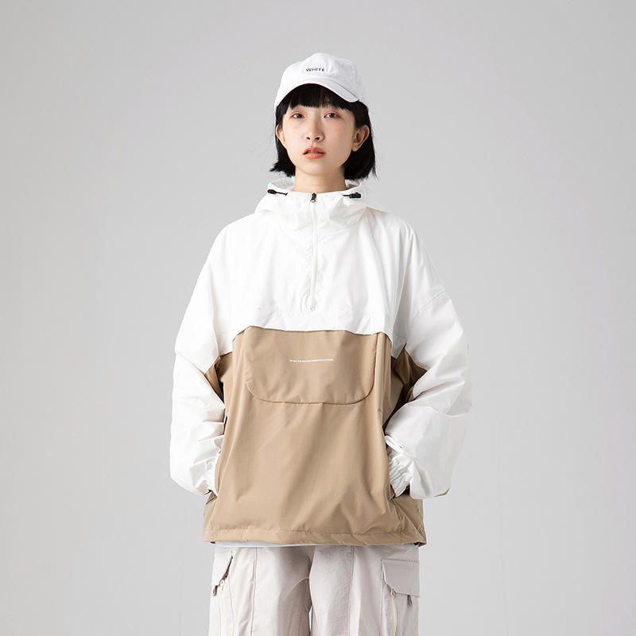
01
Men’Causal Jackets
Model Number:
BYM-6596
Description：
Color block casual
men's pullover jacket，Nylon of shell material.
MOQ:
300 pcs/design/color

Slide 5
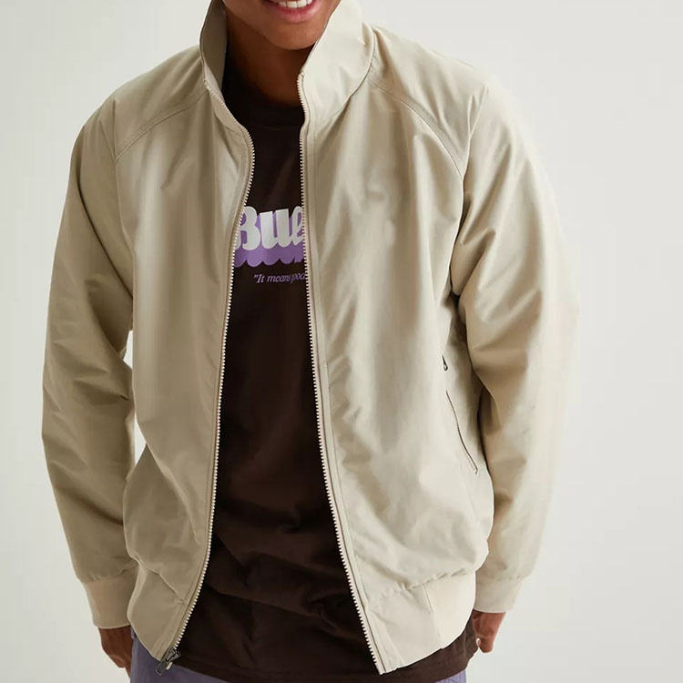
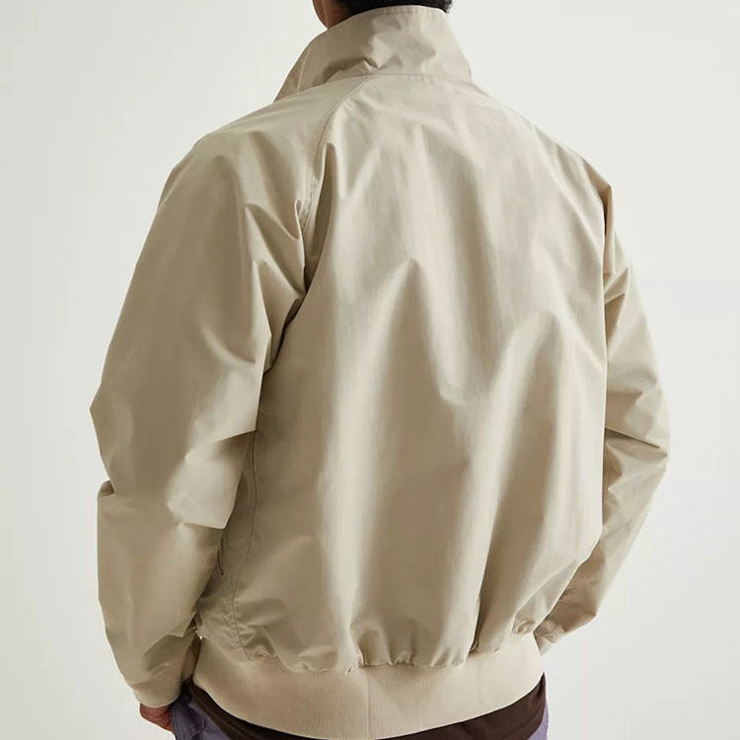
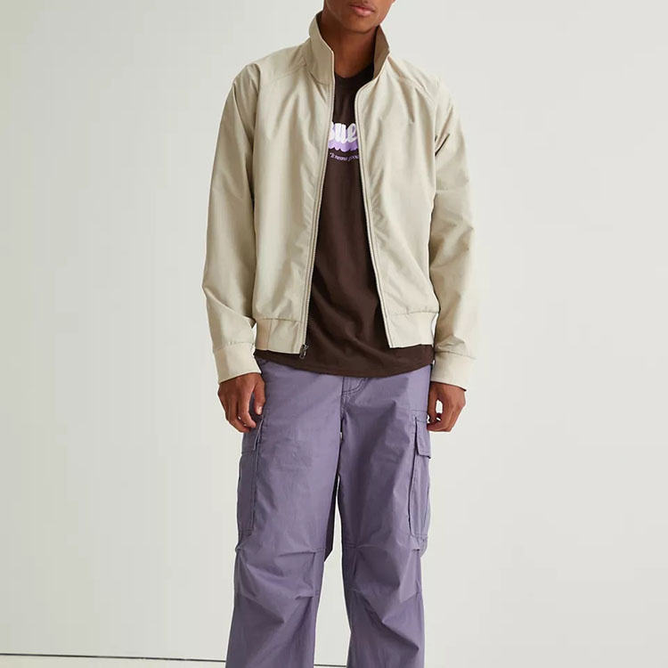
01
Men’Causal Jackets
Model Number:
BYM-6549
MOQ:
300 pcs/design/color
Feature:Quick dry, windprooft
Shell Material:Polyester

Slide 6
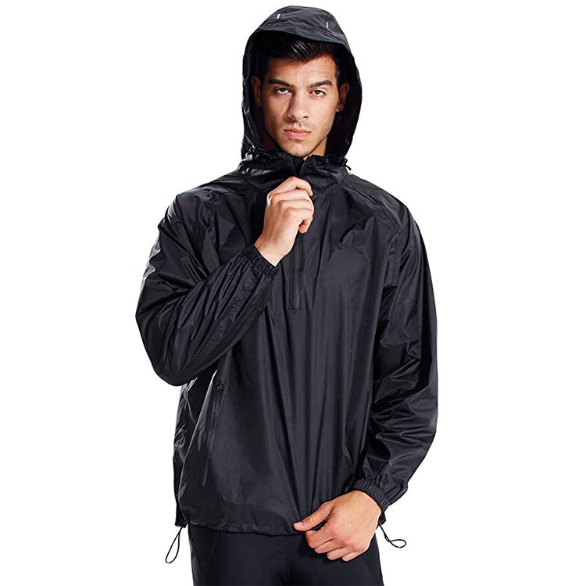
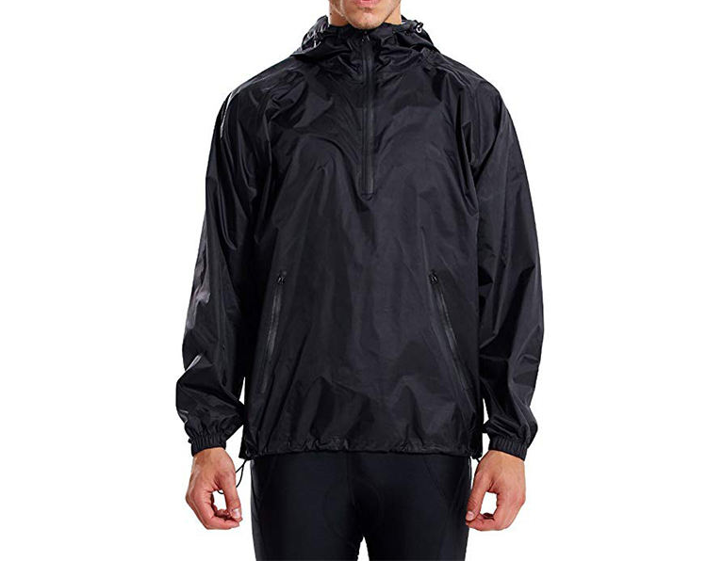
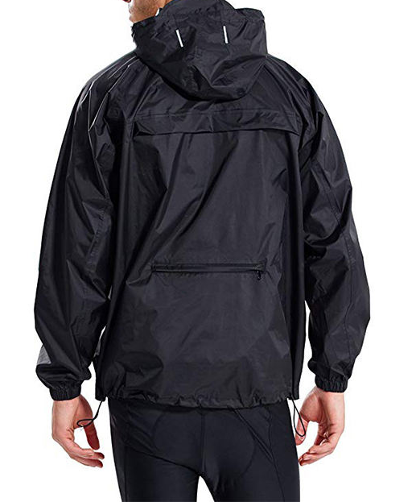
01
Men’Causal Jackets
Customized outdoor jacket
100% polyester+waterproof membrane
Waterproof Windproof Breathable
MOQ:300 pcs/design/color

Slide 7
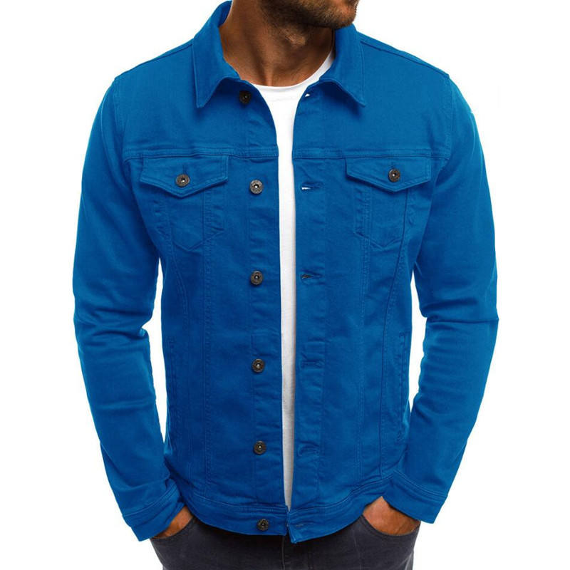
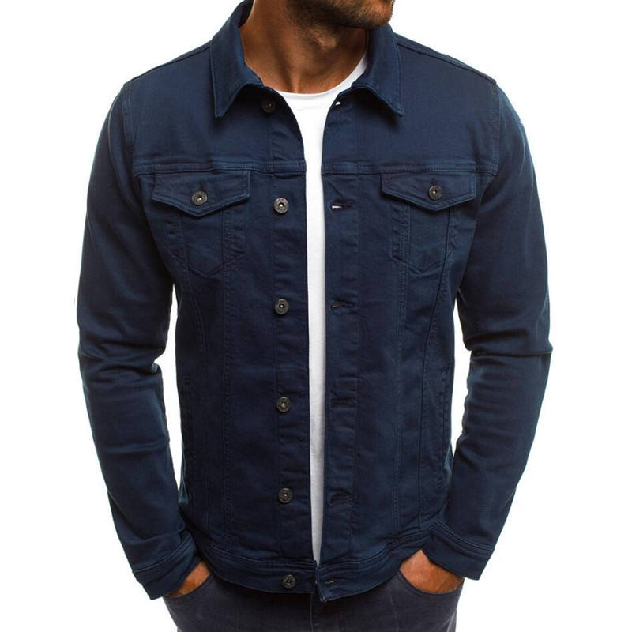
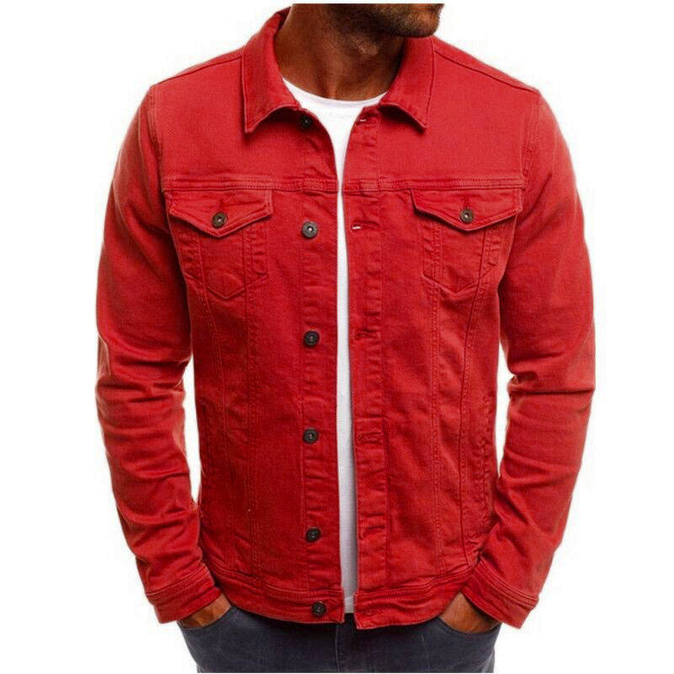
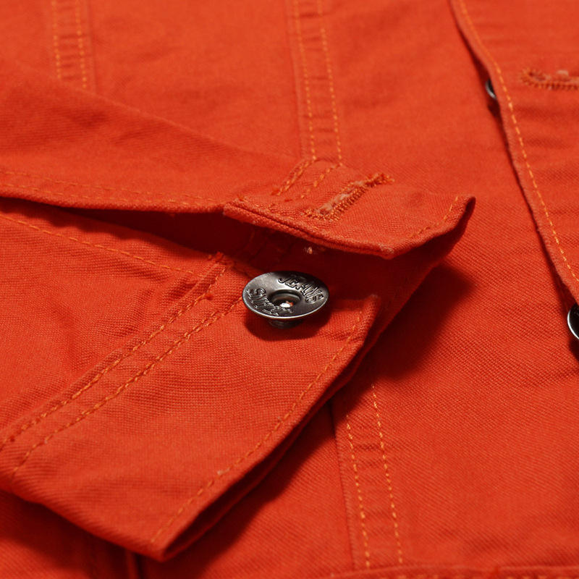
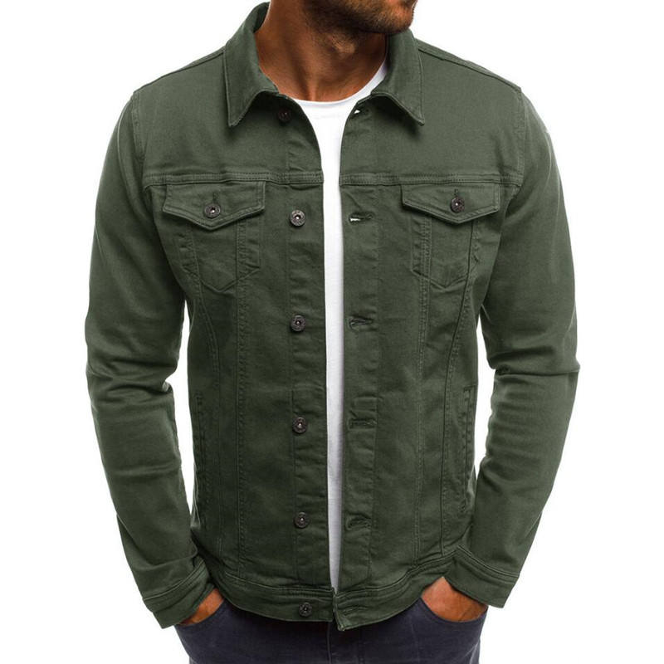
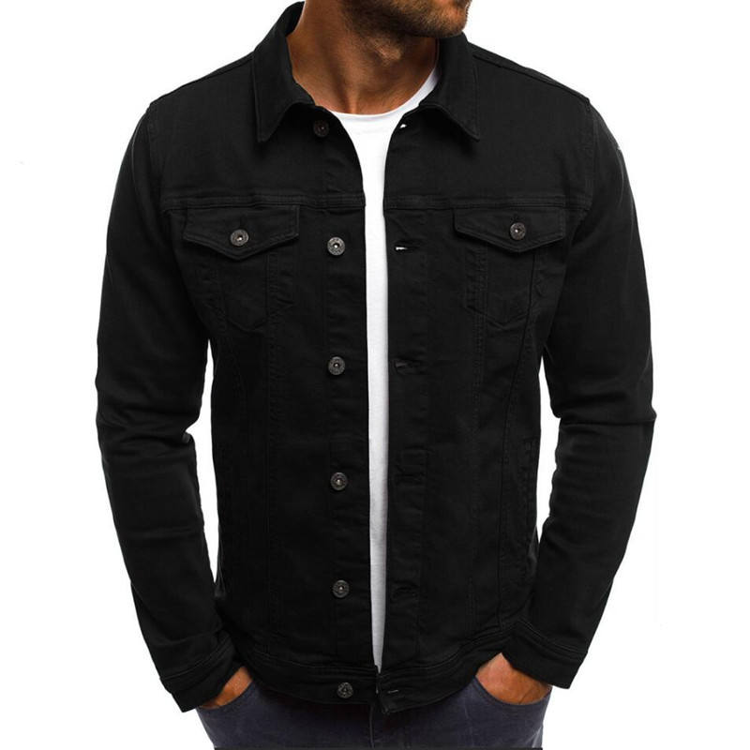
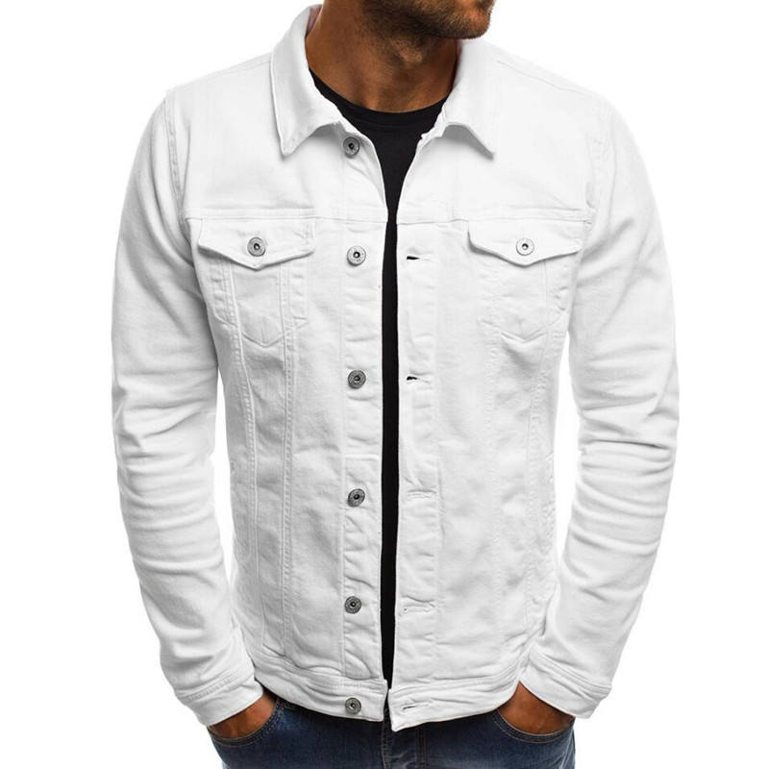
01
Men’Causal Jackets
Model Number:BYM-112
Breathable, Sustainable
Shell Material: Cotton
Plain Washed Cotton Casual Men's Jeans Jacket
Color can be customized

Slide 8
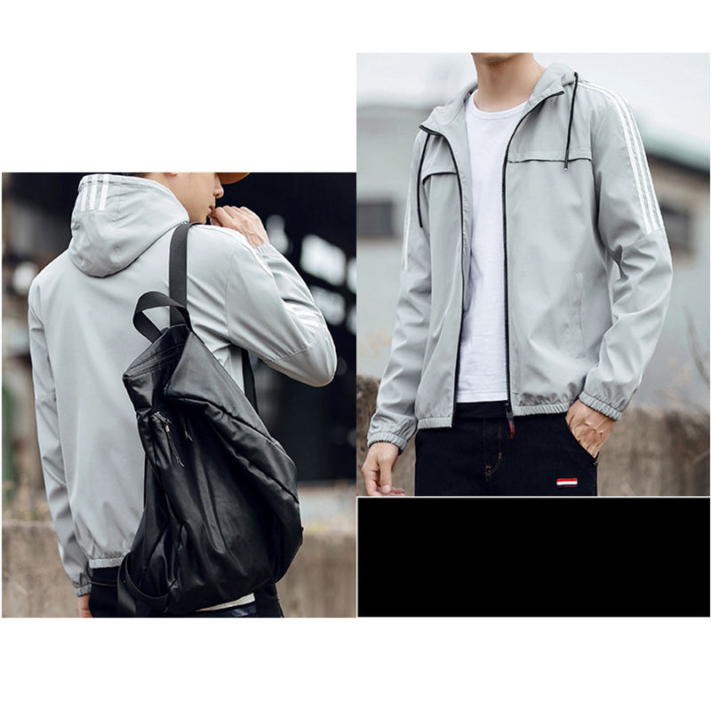
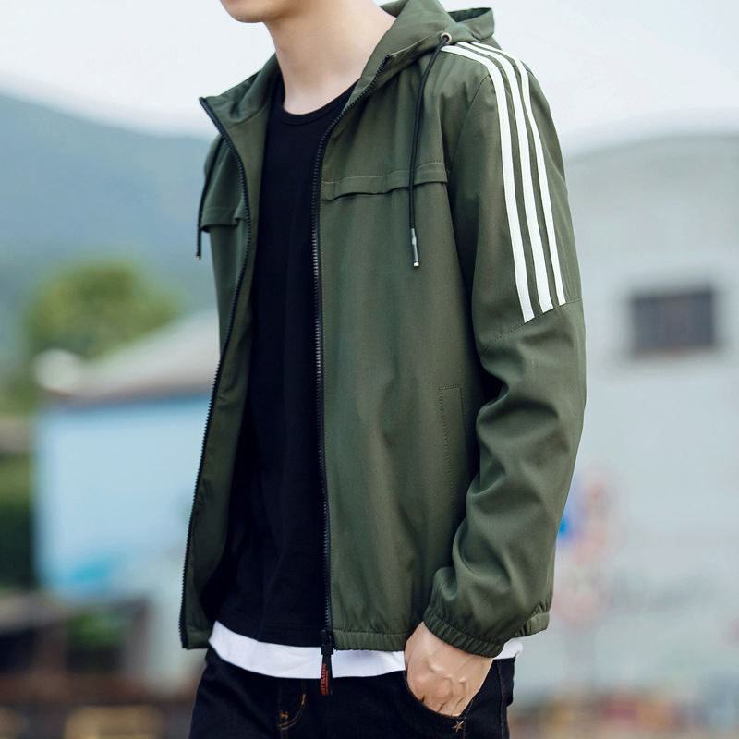
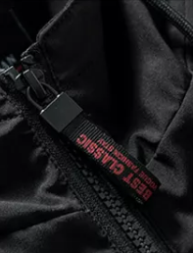
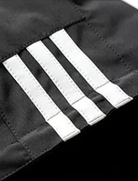
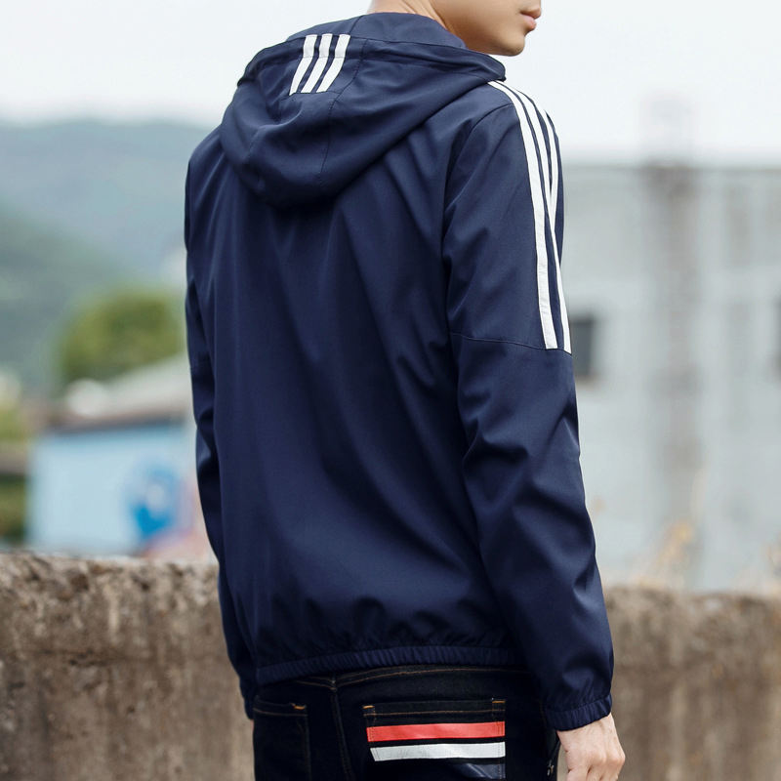
01
Men’Causal Jackets
Model Number:BYM-6501
Material: Polyester
Feature:Reversible, Breathable, Waterproof
Design:Yarn dyed,Zippers and stripes can be customized
MOQ:300 pcs/color/design

Slide 9
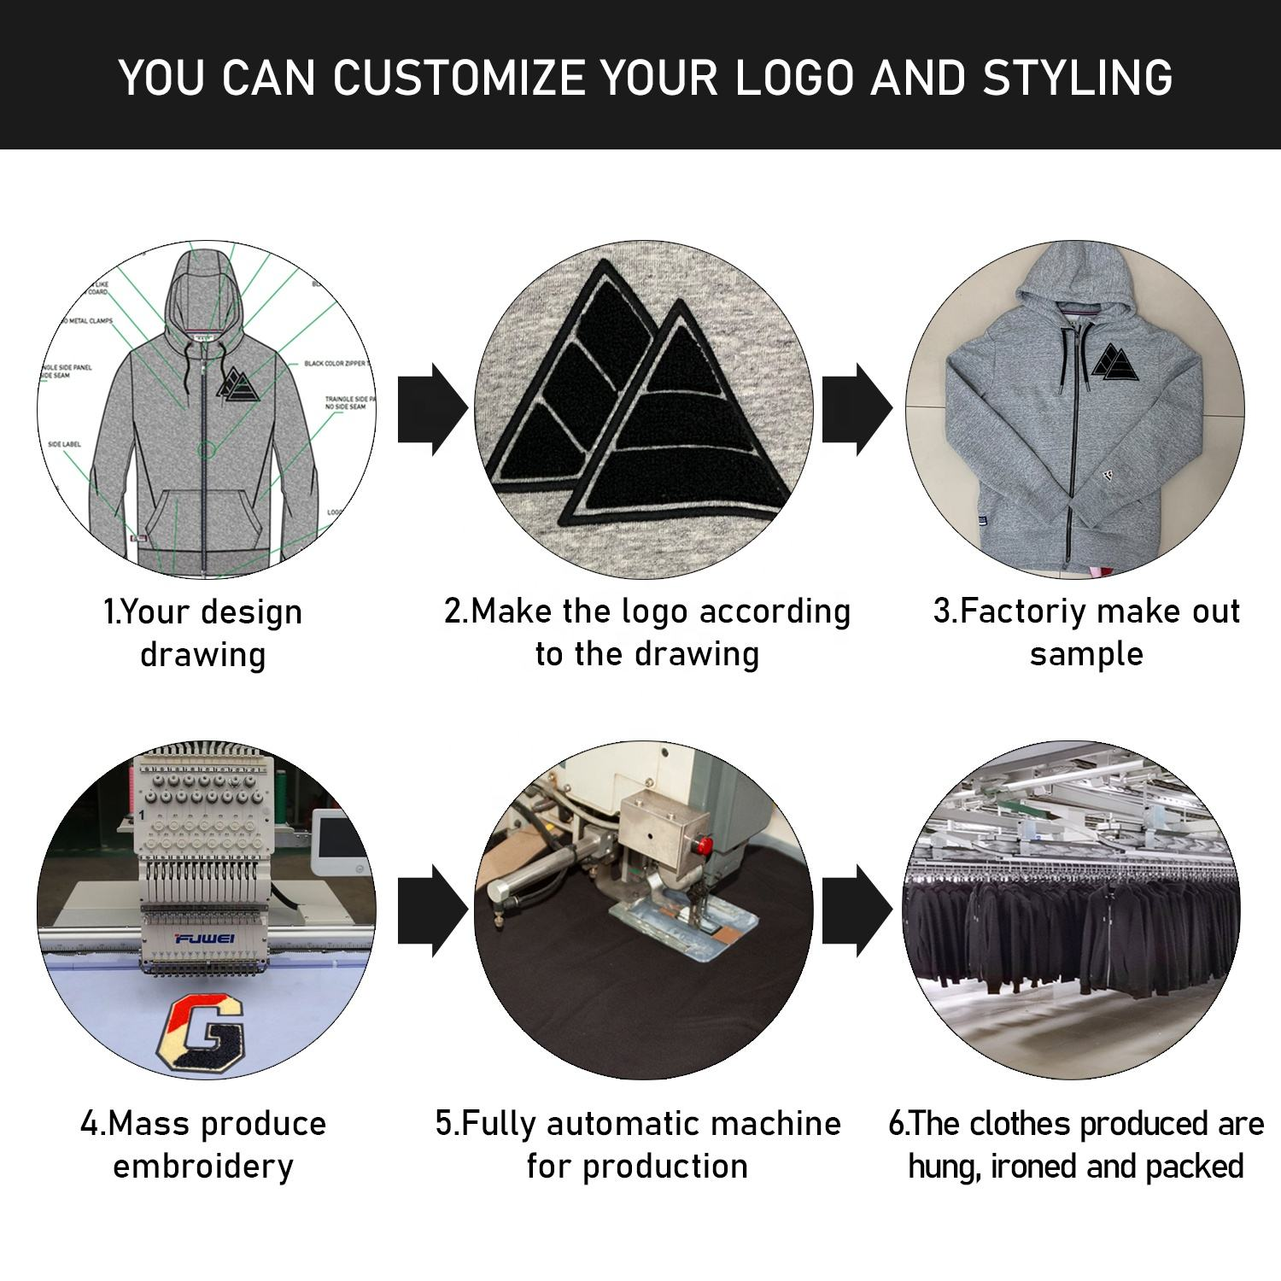
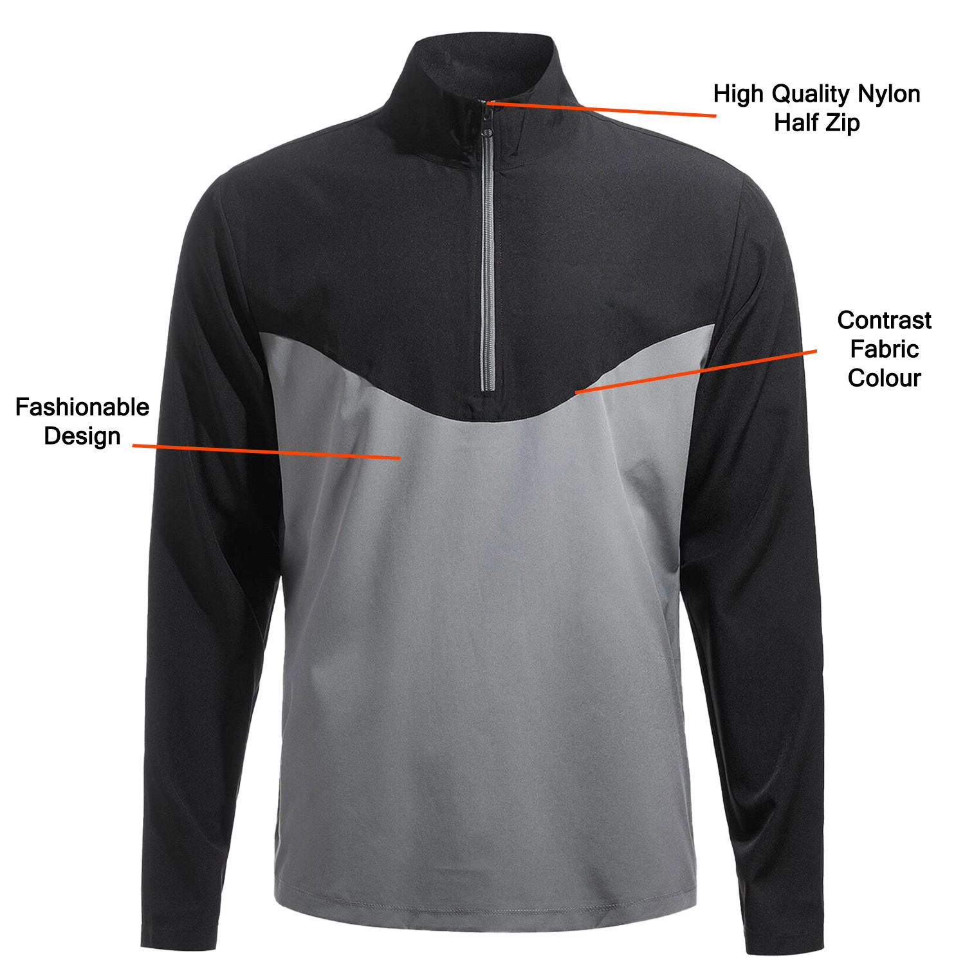
01
Men’Causal Jackets
Model Number:BYM-6545
Stand Collar Half Zip Nylon Breathable Fabric Sports and Casual Men's Jackets
MOQ: 300 pcs/design/color

Slide 10
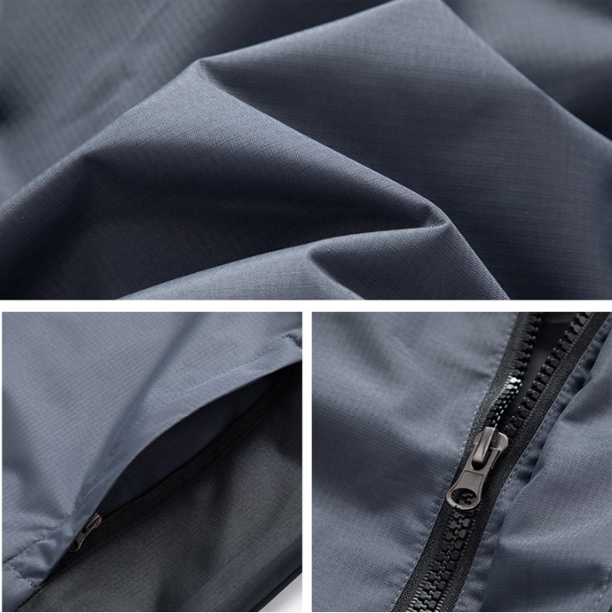
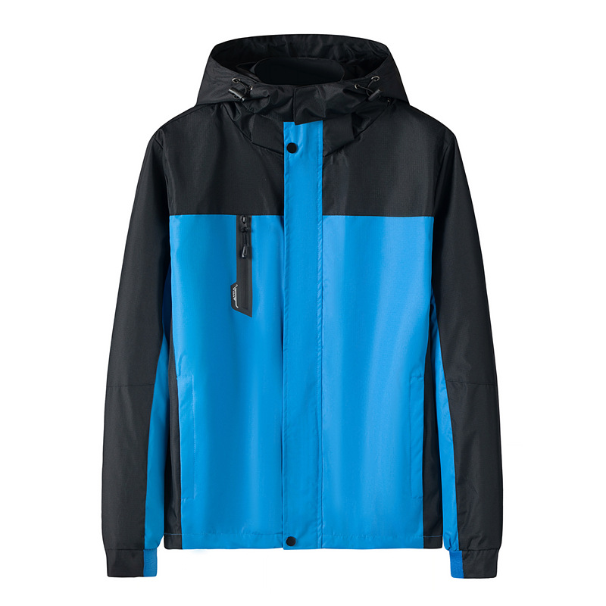
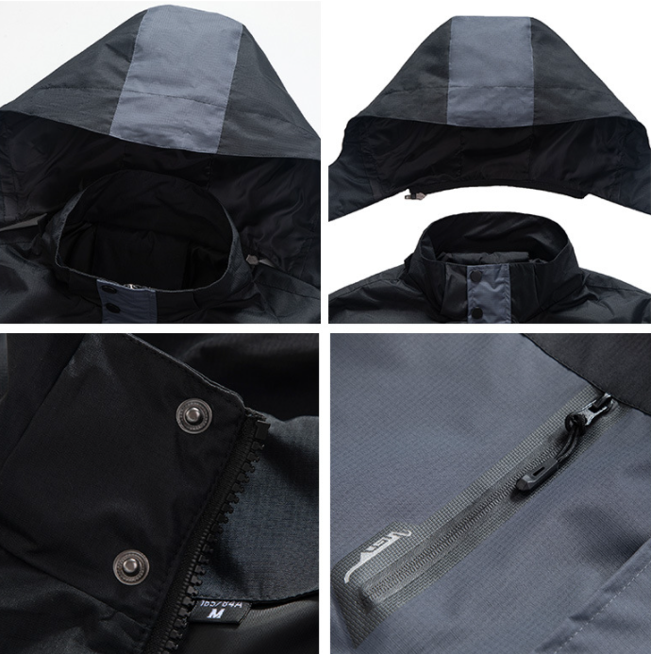
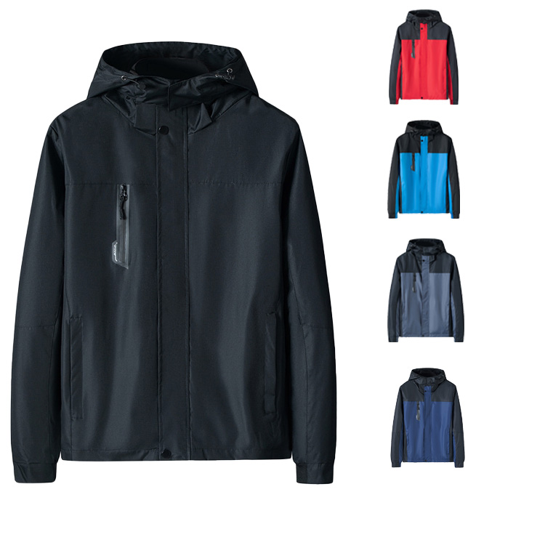
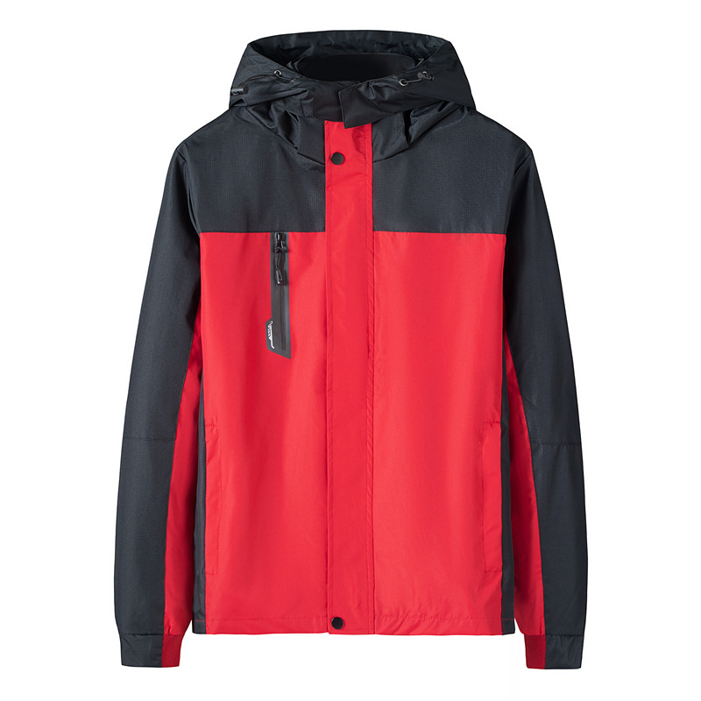
02
Men's softshell jackets
Outdoor Sport Softshell Jackets
Model Number:BYM-4523
Filling:100% Polyester Fiber
Shell Material:100%Polyester
Logo: Customer Logo OEM
Technics:Plain Dyed
Label:Accept Customized Labels

Slide 11
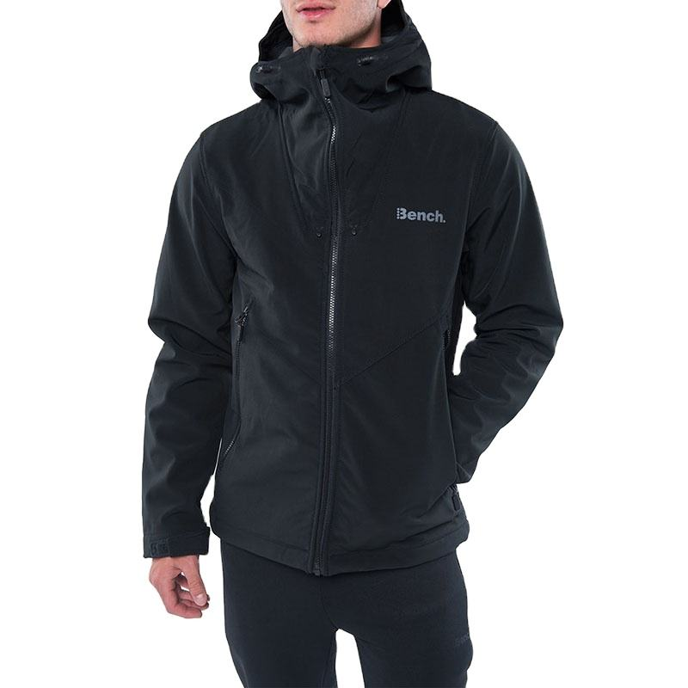
02
Men’Softshell Jackets
Model:BYM-4569
Fabric Type:90% POLYESTER 10% ELASTANE
Feature： Breathable, Plus Size, Windproof
MOQ: 300 pcs/design/color

Slide 12
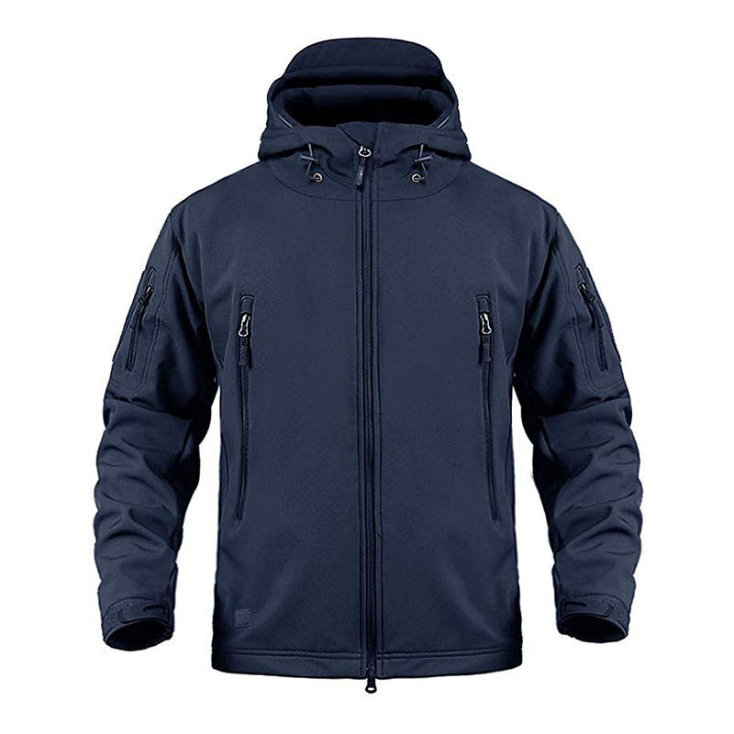
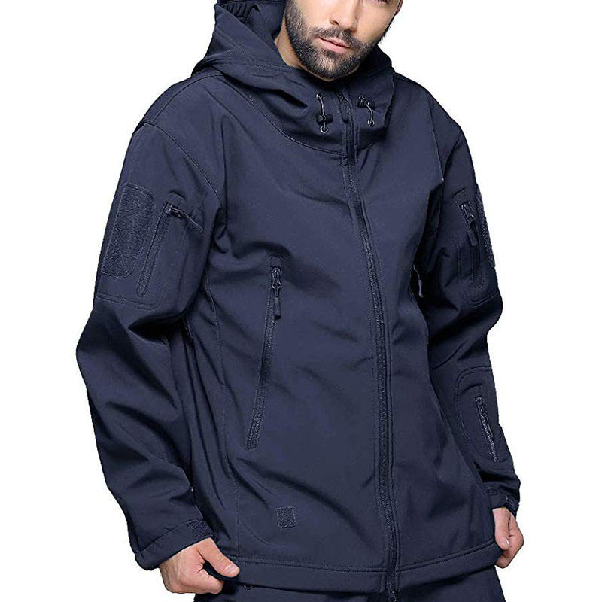
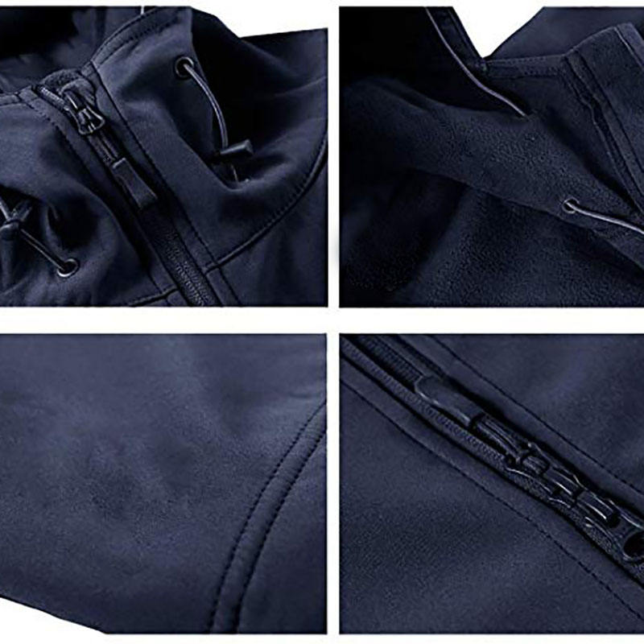
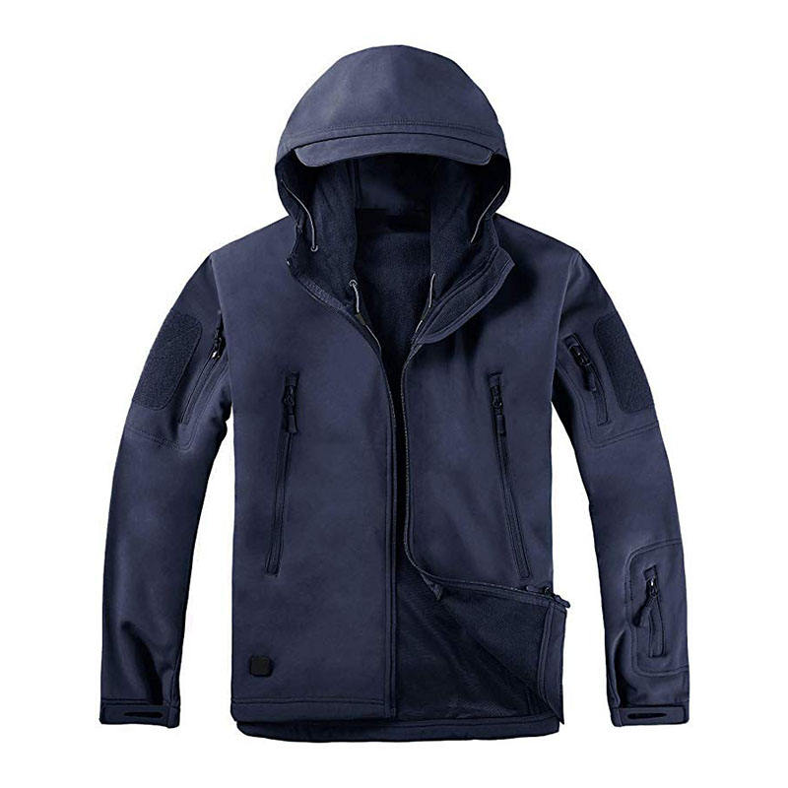
02
Men’Softshell Jackets
Model:BYM-4564
Keywords:
Waterproof Camo Softshell Jacket
Fabric : 100%%POLYESTER
Size:S-3XL + Custom Sizes
MOQ: 300 pcs/design/color

Slide 13
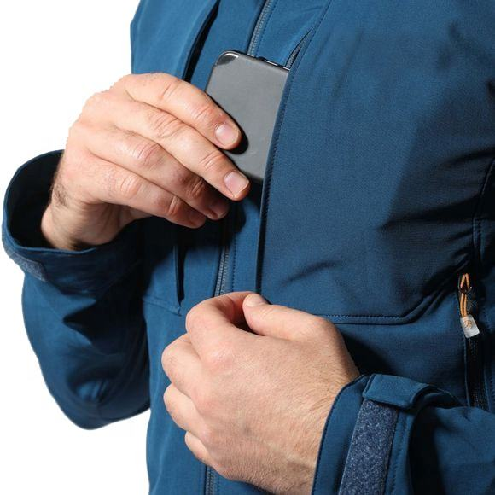
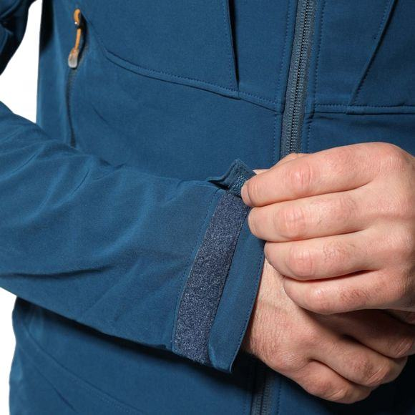
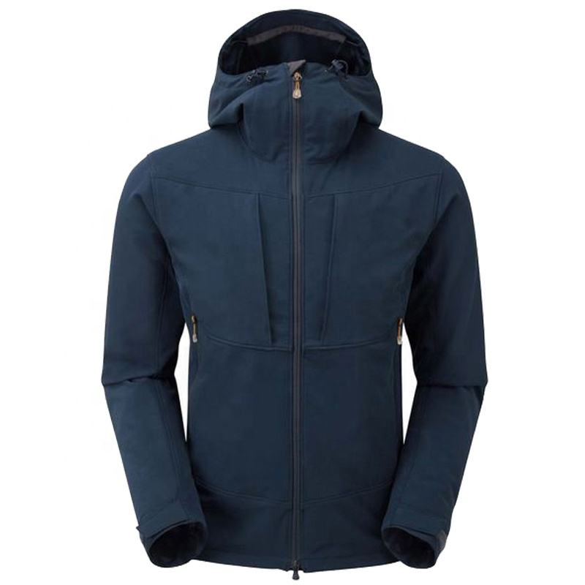
02
Men’Softshell Jackets
Model:BYM-4588
Fabric : Softshell faric bonded fleeceDetails:
1) Stand-up collar with hoody
2) Adjustable hoody
3) Front chest pockets with zip and cover
4) Lower two side pockets with zip
5) Adjustable hook-and-loop cuffs
6) Adjustable hem
MOQ: 300 pcs/design/color

Slide 14
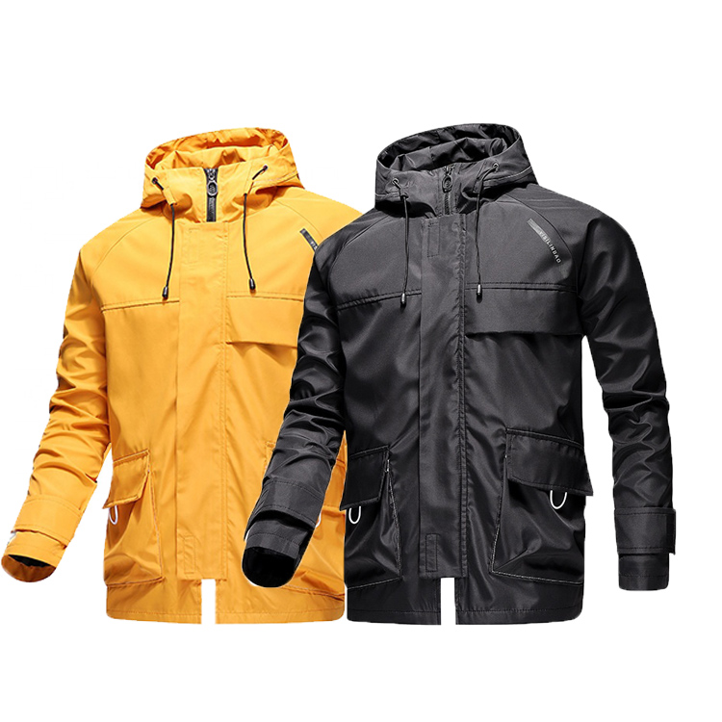
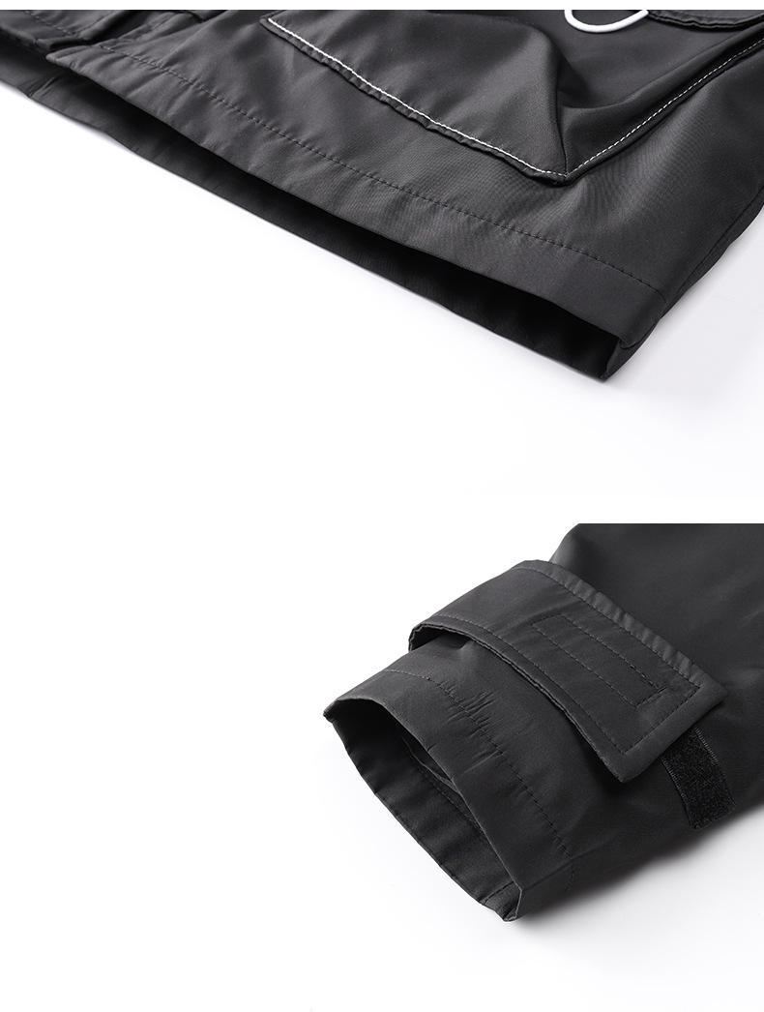
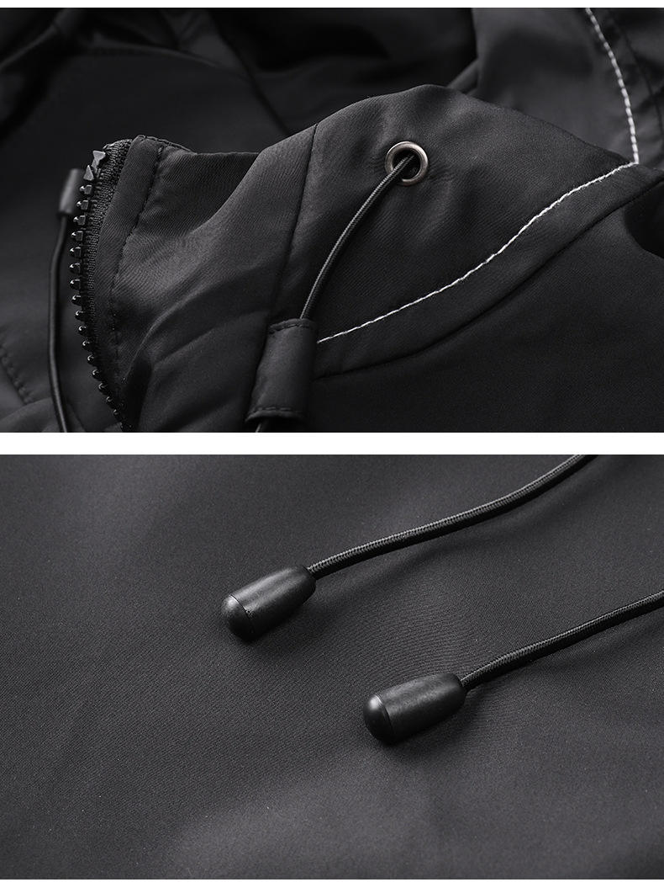
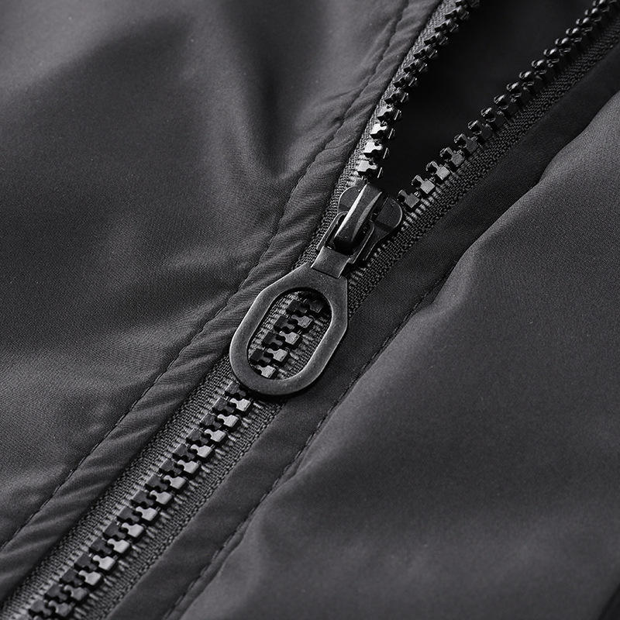
02
Men’Softshell Jackets
Model:BYM-4588
Fabric : Spandex / Polyester
MOQ: 300 pcs/design/color
Feature:Breathable, Sustainable, Windproof

Slide 15
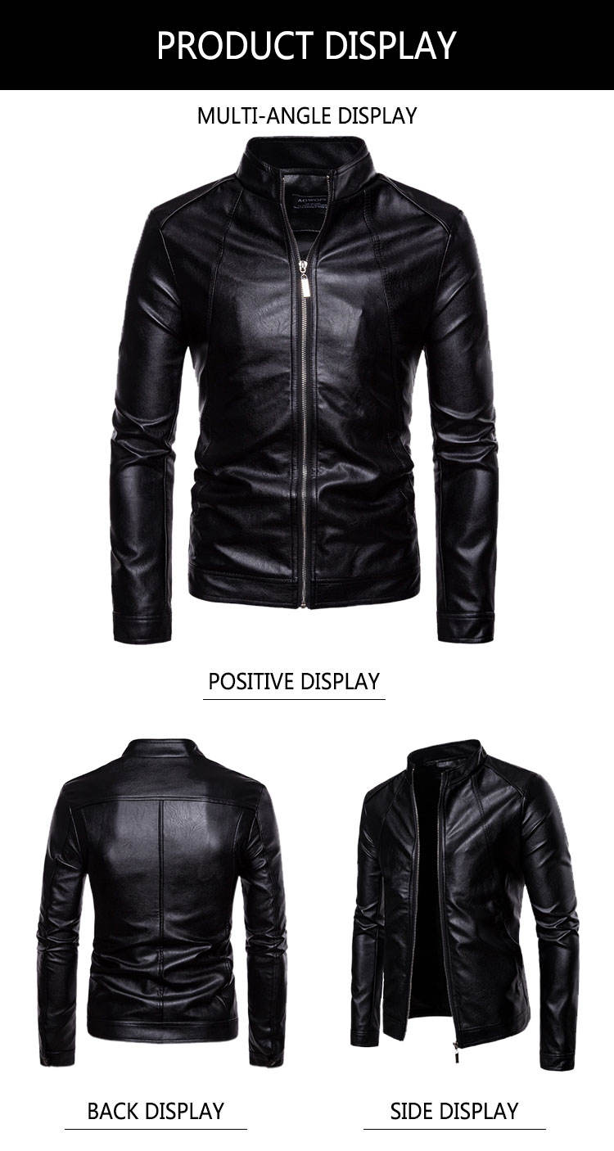
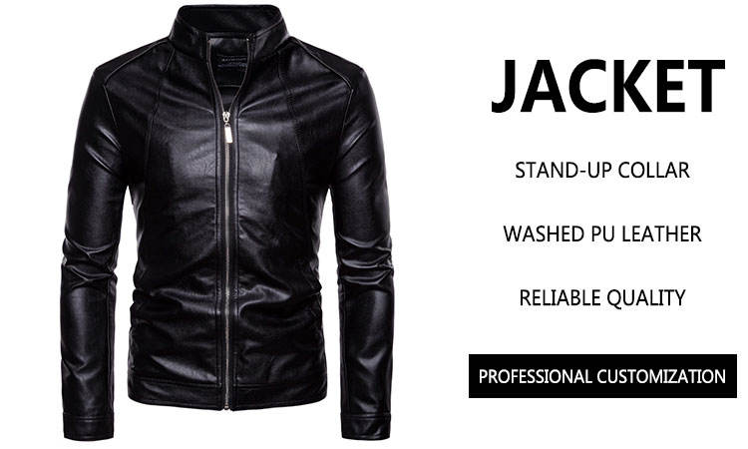
03
Men's faux leather jackets
BYM-1647 Fashion Designs Boys Classic Biker Jacket Motorcycle Pu Faux Leather Jacket For Mens Blazer Masculino Slim Fit Leather Coat

Slide 16
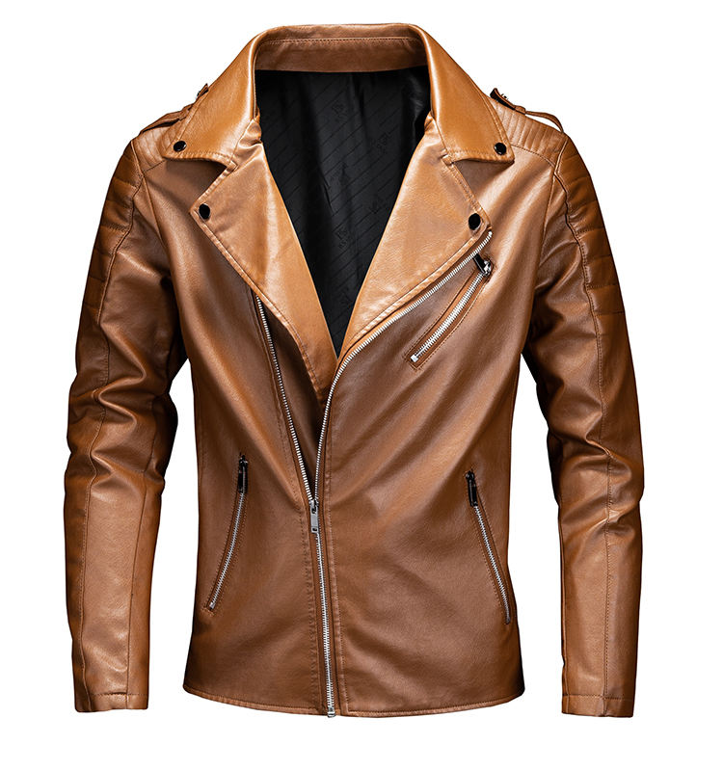
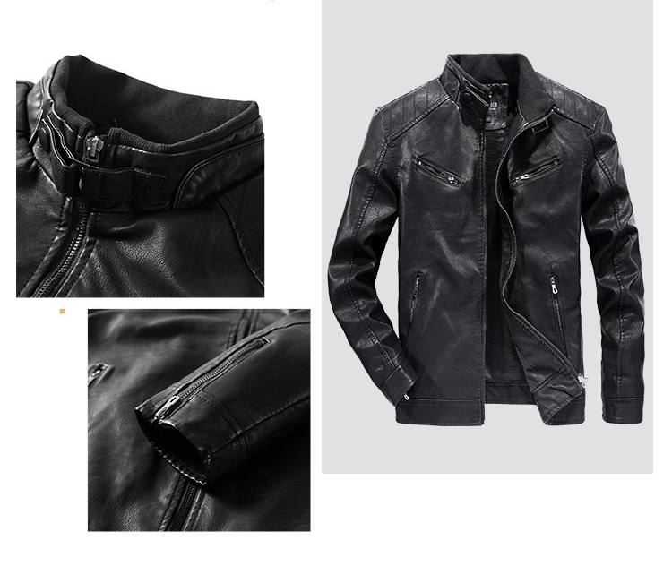
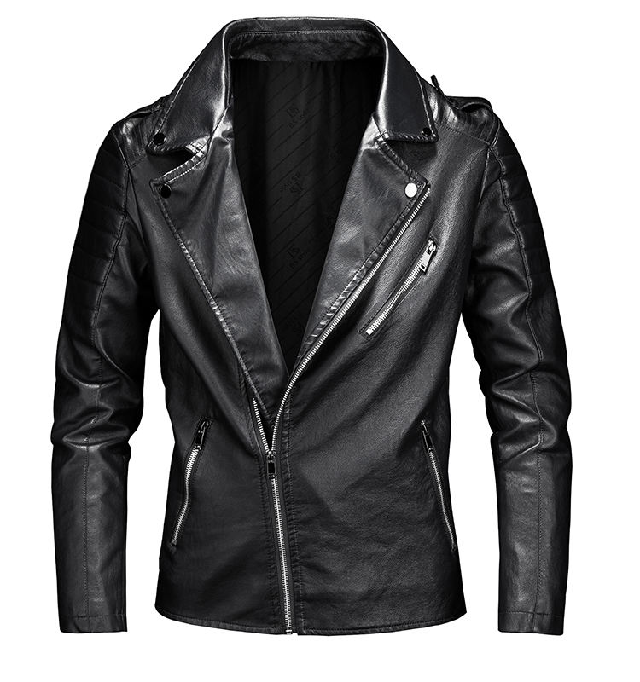
03
Men's faux leather jackets
Model:BYM-4576
Material: Faux Leather
MOQ: 500 pcs/design/color
Feature:Breathable, Sustainable, Windproof

Slide 17
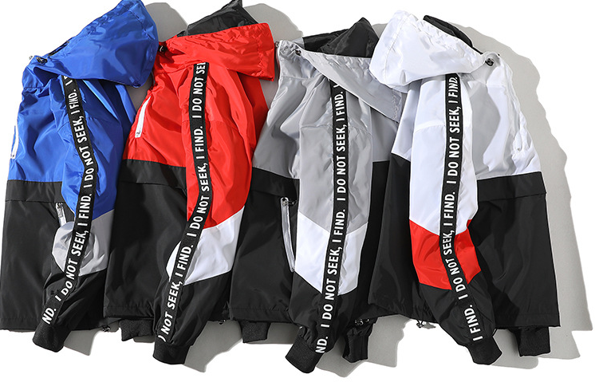
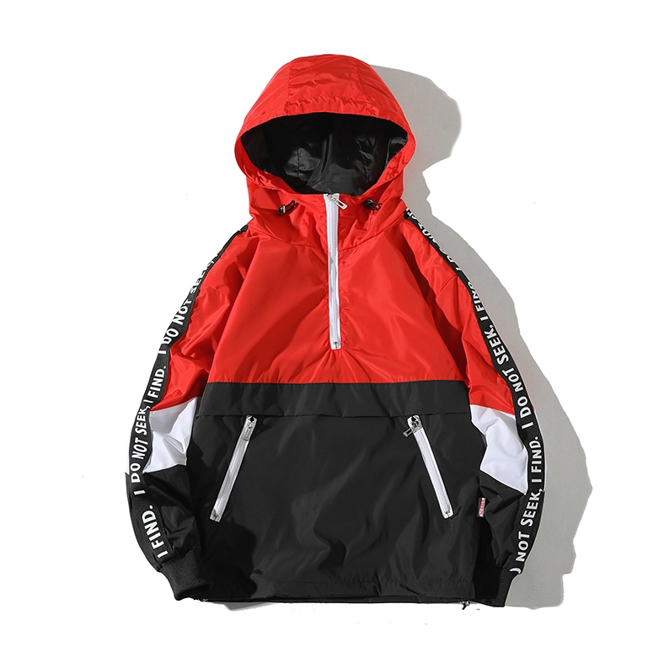
04
Men's windbreakers
Windproof jacket Custom men’s hooded pullover Windbreaker
Model:BYM-4542 MOQ: 300 pcs/design/color
Material: Polyester, 100% Polyester
Technics: Plain Dyed

Slide 18
04
Men's windbreakers
New Design Hooded Zip Up Wind Breaker Windbreaker Hoodie JacketModel:BYM-6985 MOQ: 300 pcs/design/color
Material: Polyester, 100% Polyester
Technics: Plain Dyed

Slide 19
04
Men's windbreakers
Mens Half Zipper Nylon Windbreaker Jackets Plus Size
Waterproof Pullover Windbreaker Jacket
JacketModel:BYM-6963 MOQ: 300 pcs/design/color
Material: Polyester, 100% Polyester Technics: Plain Dyed

Slide 20
04
Men's windbreakers
Polyester Nylon Waterproof Custom Mens Jacket WindbreakerJacketModel:BYM-5363
MOQ: 300 pcs/design/color Technics: Plain Dyed
Material: Polyester, Nylon

Slide 21
05
Men's Baseball Jackets

Slide 22
05
Men's Denim Jackets
Model Number:BYM-5363
MOQ: 300 pcs/design/color
Color：Black/Dark Blue/Light Blue
Fabric Type: Denim

Slide 23
06
Jackets Exhibition

Slide 24
06
Jackets Exhibition

Slide 25
Sanbai— Apparel Manufacturer
SANBAI APPAREL
ADD: B206 FuXin Building, 2nd Industrial Area, HouTing,
Shajing Town, Bao'an District, Shenzhen, Guangdong, China
Tel/WhatsApp：+86 13751957101
E-mail：danni@szsanbai.com
Website: https://luckyfashionanfu88.en.alibaba.com

